Slide 1


CSS Position
Notes:
Get connected
Self introduction
Engagement questions
Will have gifts if you can answer questions
——
How many of you didn’t know HTML/CSS before?
How many of you already know HTML/CSS?
How many of you never heard about HTML/CSS?

Slide 2


Slide 3
Agenda
CSS Position
Labs
Q & A

Slide 4
CSS Position Overview

Slide 5
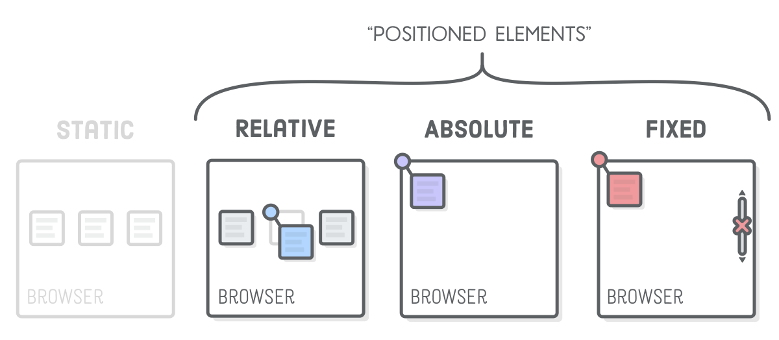
Positioned Elements
Ref: https://internetingishard.com/html-and-css/advanced-positioning/

Slide 6
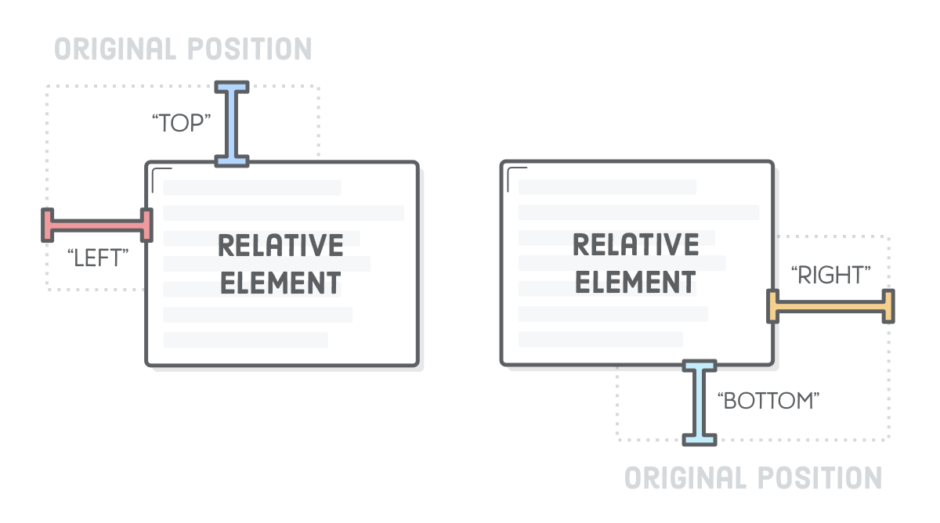
Supported Properties

Slide 7
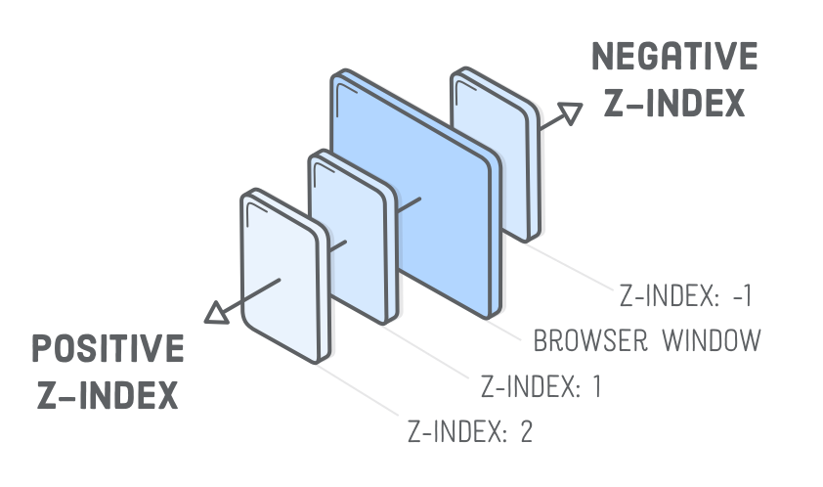
Z-index

Slide 8
Position Static

Slide 9
Position Static
Default position
Follow document flow
// Manually set static
.static {
position: static;
border: 3px solid #73AD21;
}
// Default position is static
.static {
border: 3px solid #73AD21;
}

Slide 10
Position Fixed

Slide 11
Position Fixed
Fixed position with browser even when scrolling
Removed from document flow
// Fixed: Top Left
.fixed {
position: fixed;
top: 16px;
left: 8px;
}

Slide 12
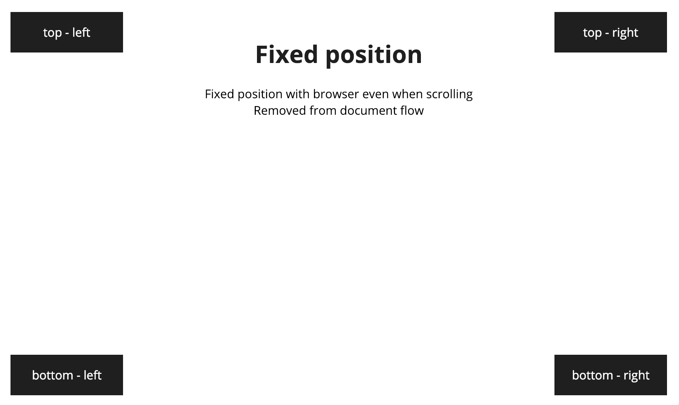
What will we code?

Slide 13
Position Absolute

Slide 14
Position Absolute
Absolute position with the nearest positioned parent
Removed from document flow
// Positioned parent
.positioned-parent {
position: relative;
}
.absolute-child {
position: absolute;
top: 16px;
left: 8px;
}

Slide 15
Position Relative

Slide 16
Position Relative
Not removed from document flow
Can be moved to another position
Usually use with position absolute
// Still taking spaces
.relative {
position: relative;
top: 16px;
left: 16px;
}

Slide 17
Position Comparison
 | Static | Relative | Absolute | Fixed
Default | Yes | - | - | -
Positioned Elements | No | Yes | Yes | Yes
Removed from doc | No | No | Yes | Yes
Can use top, left, bottom, right | No | Yes | Yes | Yes

Slide 18
Position Sticky demo

Slide 19
Refs
https://internetingishard.com/html-and-css/advanced-positioning/
https://css-tricks.com/almanac/properties/p/position/
https://www.w3schools.com/css/css_positioning.asp
https://cssreference.io/positioning/

Slide 20


Slide 21

Thank You And see you ;)

